Slide 1
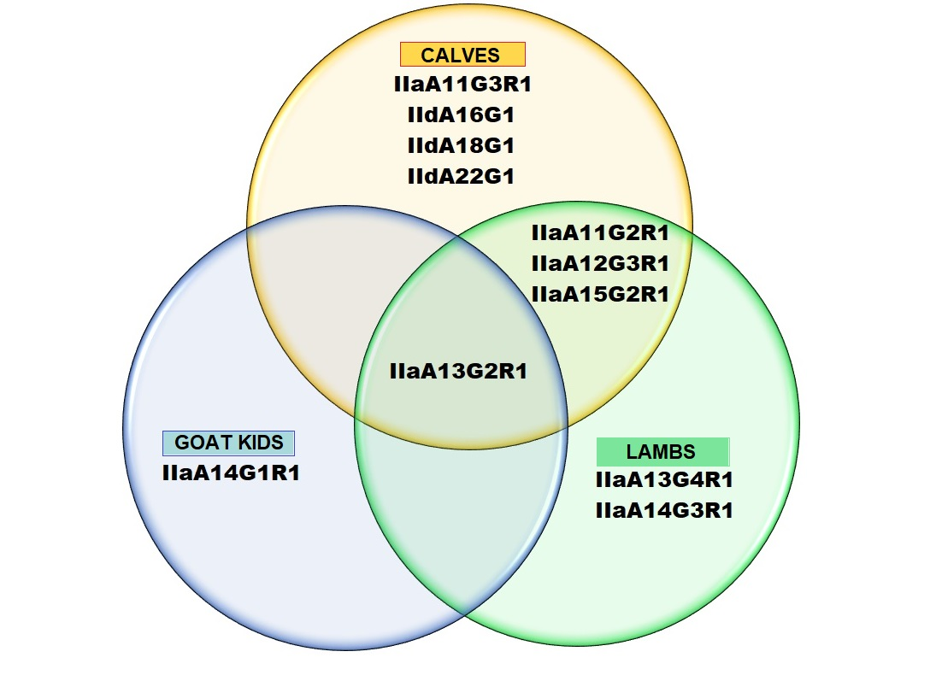
Cryptosporidium parvum subtypes in hosts

